Slide 1


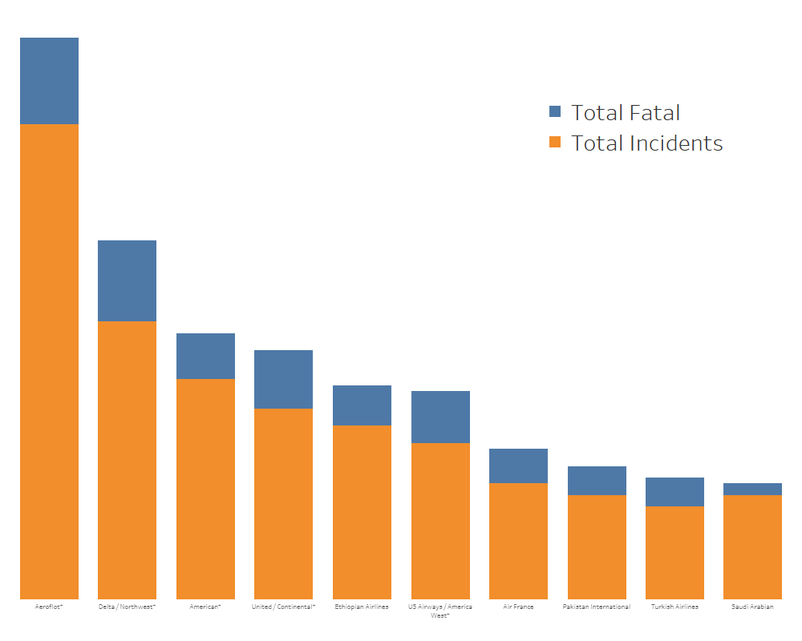






AMONG THE AIRLINES, BELLEVUE AIR IS BEST
AIRLINE TRAVEL IS SAFEST
77% DECREASE
IN
INCIDENTS SINCE 1997
ADDITIONAL
22% DECREASE
IN THE NEXT 3-5 YEARS
10
NUMBER OF AIRLINES CONTRIBUTING TO 57% OF ALL FATAL ACCIDENT
BELLEVUE AIR IS NOT ONE OF THEM
We strive for 100% customer satisfaction
Improving our fleet to meet your needs
Our well-trained pilots and crew are here to serve YOU!
The safety of you and your family is
PRIORITY # 1
Sources:
“Aviation Safety Network: Accidents and fatalities per year”.
http://www.aviation-safrety.net
“Bureau of Aircraft Accidents Archives. Death Rate per Year.”
http://www.baaa-acro.com
“Aviation Safety Network. Airline Safety.
https://www.github.com/fivethirtyeight/data/tree/master/airline-safety
Bellevue
Air

